Slide 1
HMT 801 Travel Agency and Tour Operations
UNIT 5
Travel Bodies and Association
Topic
History, aims and role of IATA
Course Outcome (CO)
CO5: Evaluate the Sustainability of Travel operations and activities of travel bodies and associations

Slide 2
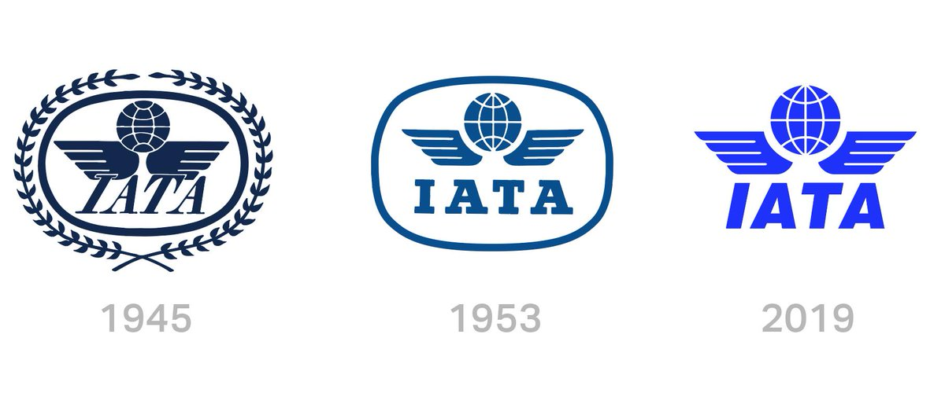
International Air Transport Association (IATA)
The International Air Transport Association (IATA) is the trade association for the world’s airlines, representing some 275 airlines or 83% of total air traffic.
In the first week of March 2021, Muhammad Ali Albakri was appointed senior vice president for customer, financial and digital services at IATA replacing Aleks Popovich. Due to the COVID-19 pandemic, IATA has announced its mobile app The IATA Travel Pass to be launched in mid-April 2021 to aid the travellers comply different requirements of changed flight policies of different governments.

Slide 3

IATA
Vision: To be the force for value creation and innovation driving a safe, secure and profitable air transport industry that sustainably connects and enriches our world.
Mission: IATA’s mission is to represent, lead, and serve the airline industry.
Representing the airline industry: They improve understanding, Sensible regulation, and increase in profitable outcome.
Leading the airline industry: Provides all kinds of convenience and luxury with reduced costs and efficient services for over 70 years.
Serving the airline industry: They help airlines to operate safely, securely, efficiently, and economically under clearly defined rules. Professional support is provided to all industry stakeholders with a wide range of products and expert services.

Slide 4
Priorities of IATA
Safety- Safety is the primary priority for IATA where IATA Operational Safety Audit (IOSA) is the main organization. It is also been considered mandatory in several countries. 2012 was considered as the safest year by aviation.
Security- Security is equally important due to the existence of heavy threats as well as possibility of attacks.
Simplifying the Business- Simplifying the process of business by electronic tickets e-tags, web check in etc.
Environment- IATA members and all industry stakeholders have agreed to three sequential environmental goals:
1) An average improvement in fuel efficiency of 1.5% per annum from 2009 through 2020
2) A cap on net carbon emissions from aviation from 2020 (carbon-neutral growth)
3) A 50% reduction in net aviation carbon emissions by 2050 relative to 2005 levels.

Slide 5
Activities Services and Functions of IATA
IATA was formed with the below discussed objectives:
To promote safe, regular and economical air transport for the benefit of the people of the world, to foster air commerce and study the problems connected therewith
To promote means for collaboration among air transport enterprises engaged directly or indirectly in international air transport service.
To cooperate with ICAO and other international organisations. There is always close association and dialogue between ICAO and IATA.

Slide 6
IATA engages itself in wide range of activities and function by providing service in the below listed areas:
A. IATA Accreditation – Travel & Cargo
B. IATA Codes
C. Consultation
D. Safety & Flight Operations Solutions
E. Financial Services
F. Business Intelligence and Statistics
G. Security Solutions
H. Airport Solutions

Slide 7
Summary
Air transportation is a major industry in its own right and it also provides important inputs into wider economic, political, and social processes. International Transport Organizations and air regulations play an important role in its operations at both national and international level. They help in highlighting the important issues and then solving them in light of all nations, rather than focussing on some or individual countries.
But, apart from their role, it is important to do timely developments within the individual nations based on them. And at the same time to help the poor, underprivileged and least developed economies by not only being empathetic to them, but supporting them through technology, education and training their human resource.

Slide 8


